Slide 1

Dynamic Difficulty Adjustment for a Novel Board Game
Presented by:
Pier P. Guillen
EE 570 – Artificial Intelligence
December 7th, 2010

Slide 2
Outline
Introduction
1st Paper: “Game Playing: The Next Moves”
2nd Paper: “Evolutionary Game Design”
3rd Paper: “AI for Dynamic Difficulty Adjustment in Games”
Implementation: game rules
Implementation: program
Implementation: experimental results
Conclusions and future work

Slide 3
Introduction
Programs can now beat competent players, grandmasters or even solve games.
Some games are still elusive.
The field is looking for new challenges.
Personal goal: design a novel game and implement the AI.

Slide 4
Outline
Introduction
1st Paper: “Game Playing: The Next Moves”
2nd Paper: “Evolutionary Game Design”
3rd Paper: “AI for Dynamic Difficulty Adjustment in Games”
Implementation: game rules
Implementation: program
Implementation: experimental results
Conclusions and future work

Slide 5
Game Playing: The Next Moves
By Susan L. Epstein, The City University of New York, 1999.
Overview:
  Defines important concepts in game solving.
  Reviews the state of AI in board games at the time.
  Proposes three challenges.

Slide 6
Game Playing: The Next Moves
Reasons to continue to do research:
  Humans have fascination towards games.
  Some games can provide insight on what current approaches lack.
What is a game?
  Multi-agent, noise-free, discrete space with a finite set of pieces and set of rules.

Slide 7
Game Playing: The Next Moves
Concepts:
  Position, goal, game tree, contest, optimal move, evaluation function (perfect, heuristic), minimax algorithm, reducing search, introducing knowledge.
Games and strategies:
  Checkers (Chinook) and Chess (Deep Blue): brute force, enormous subtrees, extensive opening and closing books, evaluation functions carefully tuned.

Slide 8
Game Playing: The Next Moves
Games and strategies (cont.):
  Backgammon (Logistello), Othello (TD-gammon) and Scrabble (Maven): powerful evaluation functions, trained offline from millions of played games.
  Current targets:
    Bridge and Poker: imperfect information.
    Shogi and Go: branching factor is too big.

Slide 9
Game Playing: The Next Moves
Possible approaches:
  Spatial cognition: value features by visualizing.
  Satisfice: good enough decisions, reason from incomplete or inconsistent information, learn from mistakes.
Challenges:
  Model a contestant .
  Annotate a contest.
  Expert program teaching its skill.

Slide 10
Outline
Introduction
1st Paper: “Game Playing: The Next Moves”
2nd Paper: “Evolutionary Game Design”
3rd Paper: “AI for Dynamic Difficulty Adjustment in Games”
Implementation: game rules
Implementation: program
Implementation: experimental results
Conclusions and future work

Slide 11
Evolutionary Game Design
By Cameron Browne, Imperial College London, and Frederic Maire, Queensland University of Technology, 2010.
Overview:
  How to create combinatorial games by automatic means.
  Provides empiric measurements of quality.
  Uses an evolutionary search to produce new high-quality games.

Slide 12
Evolutionary Game Design
Little attention paid to measure the quality of games themselves.
Ludi Framework:
  Uses a Game Description Language (GDL) to define games.
  General Games Players (GGP) to interpret games and coordinates moves.
  3 modules: strategy module (planning), criticism module (quality), synthesis (generate new games).

Slide 13
Evolutionary Game Design
How to rate games:
  Use 3 aesthetic criteria.
  Intrinsic (based on rules).
  Viability (based on outcomes).
  Quality (based on trend of play).
  57 of these criteria
  Examples: completition, duration, drama and uncertainty.

Slide 14
Evolutionary Game Design

Slide 15
Evolutionary Game Design
How to create new games:
  Mating other games.
  Two parents, one is a template.
  Mutate child.
  Perform validity check.
  Score game.
  Insert into population.

Slide 16
Evolutionary Game Design

Slide 17
Evolutionary Game Design
Experiments and results:
  79 existing games evaluated and ranked.
  Results were correlated with aesthetic measurement .
  1389 games evolved from the original set, 19 deemed viable.
  New games were scored and correlated.
  Top 2 games are now commercially available.

Slide 18
Outline
Introduction
1st Paper: “Game Playing: The Next Moves”
2nd Paper: “Evolutionary Game Design”
3rd Paper: “AI for Dynamic Difficulty Adjustment in Games”
Implementation: game rules
Implementation: program
Implementation: experimental results
Conclusions and future work

Slide 19
AI for Dynamic Difficulty Adjustment in Games
By Robin Hunicke and Vernell Chapman, Northwestern University, 2004.
Overview:
  Games are meant to be engaging.
  Use probabilistic methods to adjust challenge on-the-fly.
  Creates more flexible and enjoyable experiences.

Slide 20
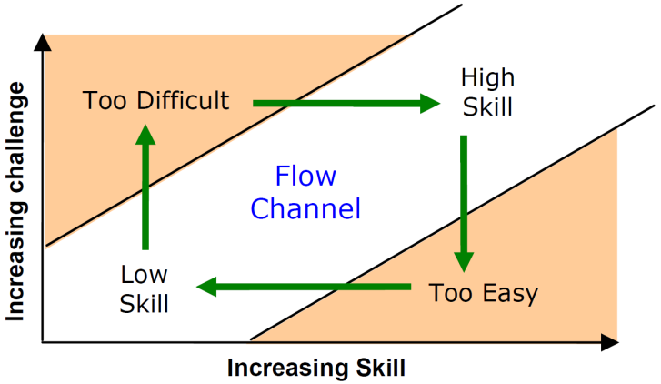
AI for Dynamic Difficulty Adjustment in Games
Approach: maintain the player on the “flow” channel.
Use Dynamic Difficulty Adjustment (DDA).

Slide 21
AI for Dynamic Difficulty Adjustment in Games
Implementation:
  Hamlet system.
  Runs on Half-Life engine.
  Metric chosen: damage.
Types of adjustments:
  Reactive (interacting elements).
  Active (off-stage elements).

Slide 22
AI for Dynamic Difficulty Adjustment in Games
Policies regulate the supply and demand of inventory.
Abstract simulations estimate outcome.
Changes are made based on this.

Slide 23
Outline
Introduction
1st Paper: “Game Playing: The Next Moves”
2nd Paper: “Evolutionary Game Design”
3rd Paper: “AI for Dynamic Difficulty Adjustment in Games”
Implementation: game rules
Implementation: program
Implementation: experimental results
Conclusions and future work

Slide 24
Game Rules
Game: Tlamatini.
Elements:
  Turned based board game.
  Two players.
  Hexagonal board, with hexagonal tiling.
  4 pieces per player, 3 types of pieces.
  3 tile states: neutral, owned or owned by rival.
Goal: Make a specific piece reach the other side.

Slide 25
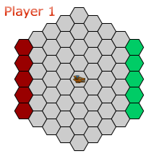
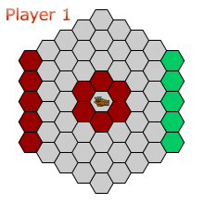
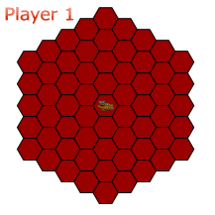

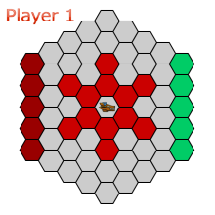
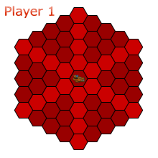
Game Rules

Slide 26
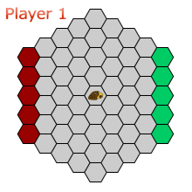


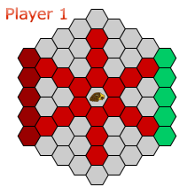
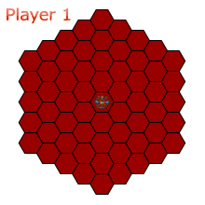
Game Rules

Slide 27
Outline
Introduction
1st Paper: “Game Playing: The Next Moves”
2nd Paper: “Evolutionary Game Design”
3rd Paper: “AI for Dynamic Difficulty Adjustment in Games”
Implementation: game rules
Implementation: program
Implementation: experimental results
Conclusions and future work

Slide 28
Program
Implemented in:
  Adobe Flash CS5.
  ActionScript 3.
Benefits:
  Rapid prototyping.
  Easy integration of multimedia elements.
  Platform independent.
  Playable online.

Slide 29
Program
AI approaches:
  General Game Playing (GGP).
  Minimaxing game tree.
Tree searching:
  Alpha-beta algorithm (negamax framework, fail-soft approach).
  Two functions; one for root.
Static evaluator: considers amount of tiles and proximity of king.

Slide 30
Program
Iterative deepening: start at depth 1 and increase while times allows.
Dynamic difficulty:
  Limit amount of computation (depth searched).
  Policy approach: calculate the probability of player winning, act accordingly.
Implemented policy:
  Threshold value on when to help.
  Counter value to not help too often.

Slide 31
Outline
Introduction
1st Paper: “Game Playing: The Next Moves”
2nd Paper: “Evolutionary Game Design”
3rd Paper: “AI for Dynamic Difficulty Adjustment in Games”
Implementation: game rules
Implementation: program
Implementation: experimental results
Conclusions and future work

Slide 32
Experimental results
Search results:
  Game has a branching factor of 20-30.
  Program search up to 4 plies.
  Flash has a 15 s. execution limit.
Gameplay results:
  Presented to half a dozen players.
  Good concept.
  Too easy to beat.

Slide 33
Experimental results
Actionscript limitations:
  AS3 has speedups of 10x over AS2.
  Is still 5-10 times lower than java; 100-500 than C.
Other people results:
  flashCHESSIII.
  Alpha evaluated 1000 nodes per move. Final version +10000 (~4 plies).
  The Elo rating of the engine at around 1500-1800.

Slide 34
Outline
Introduction
1st Paper: “Game Playing: The Next Moves”
2nd Paper: “Evolutionary Game Design”
3rd Paper: “AI for Dynamic Difficulty Adjustment in Games”
Implementation: game rules
Implementation: program
Implementation: experimental results
Conclusions and future work

Slide 35
Conclusions
Many open options of development of AI on board games.
Not possible to evaluate the implemented policy effectiveness.
Speed-up opportunities:
  Refactor and decouple.
  Profiler based optimizations.
  Fine-tune evaluation function.

Slide 36
Conclusions
Speed-up opportunities (cont.):
  Implement other common tree searching techniques:
    Transposition tables.
    Null move forward pruning.
    MTD(f) search or negascout.
    Opening and closing books.

Slide 37
Questions?
(Thank you!)

