Slide 1

Passive Thin Object Reconstruction from Uncalibrated Cameras
Erick Martin del Campo
Pier Guillen
CS 635 - Capturing and Rendering Real-World Scenes
April 29th, 2010

Slide 2
Outline
Introduction
Related work
Feature detection
Feature correspondence
Structure reconstruction
Results and demo
Conclusions and future work

Slide 3
Introduction
Motivation
Low resolution can fail to capture key parts of thin structures while high resolution might return thousands of triangles for structures that could be represented in a simpler way.
Find a robust way to capture a thin structure based on joints and lines and store this information in a lightweight representation.
Finally do a 3D reconstruction of the object using only a few photo shots of the structure taken with uncalibrated cameras.

Slide 4
Introduction
Challenges
Finding an appropriate method for a complete reconstruction of the structure. Particularly for finding the joints and the thin parts that connect them.
Finding the correspondence of different sets of points between images and reconstructing the 3D object without a previous calibration of the cameras.
Dealing with occlusion and noise.

Slide 5
Outline
Introduction
Related work
Feature detection
Feature correspondence
Structure reconstruction
Results and demo
Conclusions and future work

Slide 6
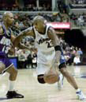
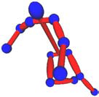
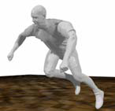
Related Work
[Remondino, Roditakis 2003]
Recover 3D model of humans using just one uncalibrated frame or a monocular video sequence.
Perspective projection:
Simplified equation, with a scaled orthographic projection:
with a scale factor

Slide 7
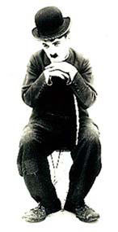
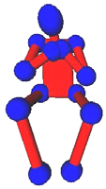
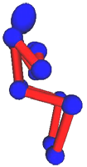
Related Work
Supposing that the length L of a straight segment between two object points is known, the distance L can be expressed as:
and combining the two last equations:
If the scale parameter s is known, we can compute the relative depth between two points as a function of their distance L and image coordinates.

Slide 8
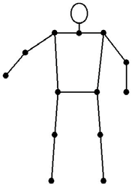
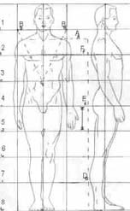
Related Work
This model can be used only considering the Z coordinate to be almost constant in the image or when the range of Z values of the object points is small compared to the distance between the camera and the object points.
The camera constant is not required and this makes the algorithm suitable for all applications that deal with uncalibrated images.

Slide 9
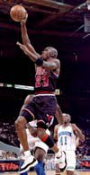
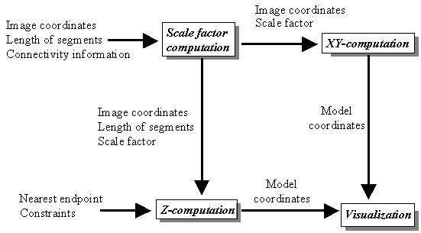
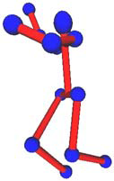
Related Work

Slide 10
Outline
Introduction
Related work
Feature detection
Feature correspondence
Structure reconstruction
Results and demo
Conclusions and future work

Slide 11
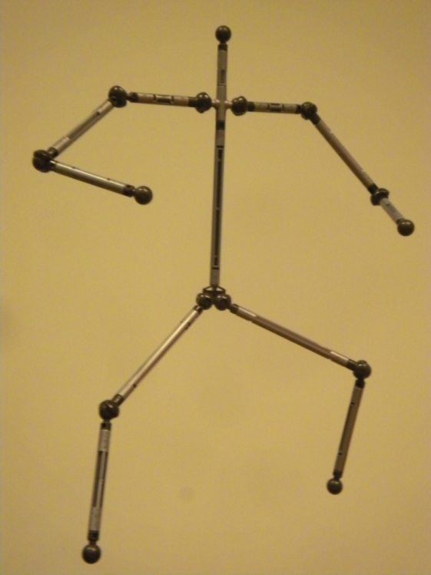
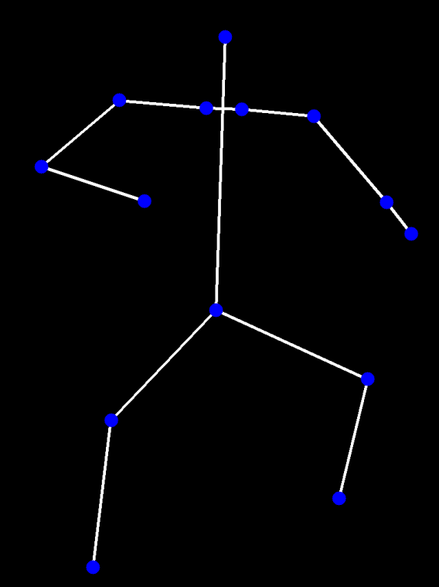
Feature detection
The main idea is to get a two dimensional graph representation of the structure, in which every node of the graph is a joint and its vertices the thin parts.

Slide 12
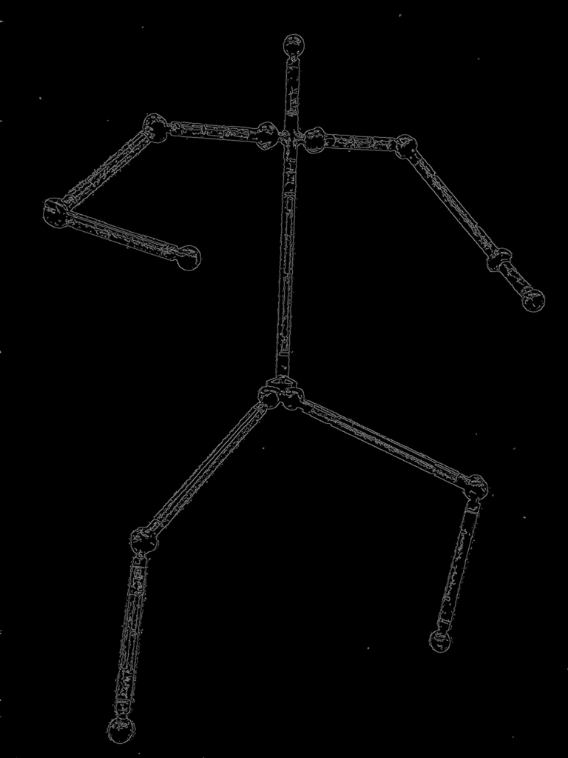
Feature detection
First, use [Canny, 1986] method to detect the edges of the figure.

Slide 13
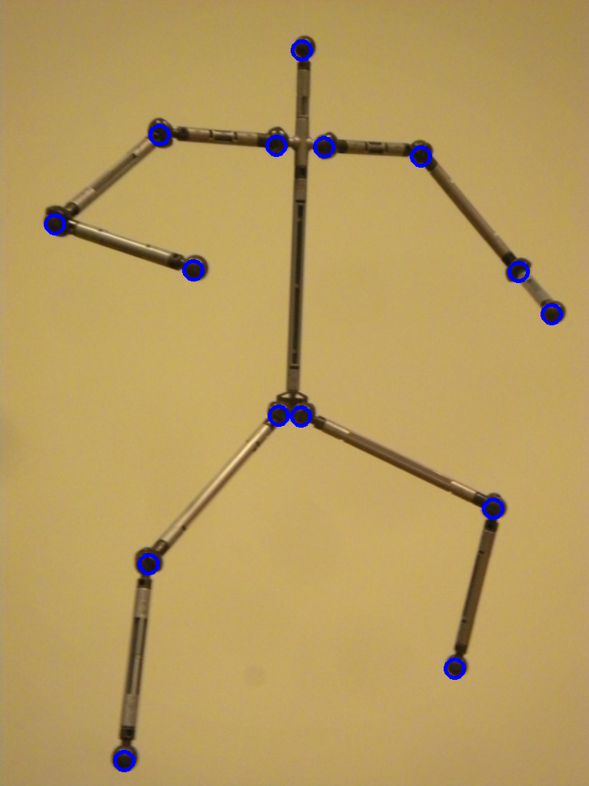
Feature detection
Then, use [Yuen 1990] circles detection algorithm, taking advantage of the rounded symmetry of the joints.

Slide 14
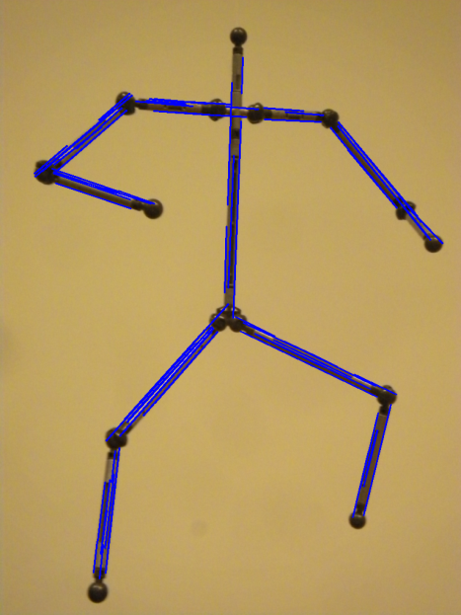
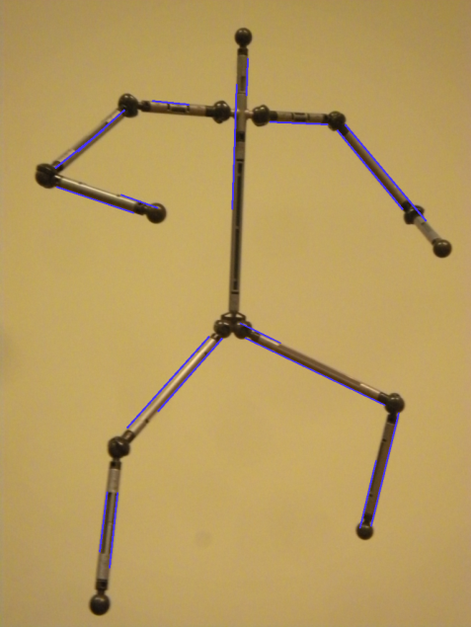
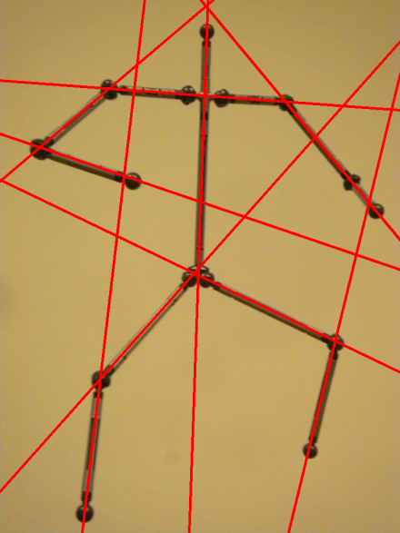
Feature detection
Then, apply probabilistic Hough transform as described in [Matas, 00]
Now, we have infinite lines represented by its and
This way, we can determine the intersection of the lines with:

Slide 15
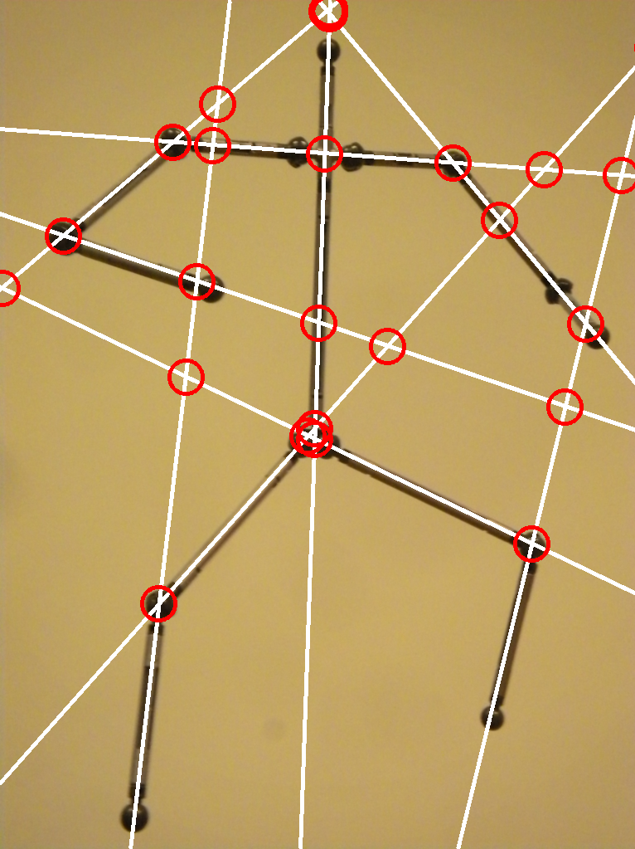
Feature detection
This intersection points are useful as filters for extra joints detected on the previous step, and for other error correction problems.
We use this data to cast a negative integer vote against joints which are not close enough to an infinite line or an intersection.

Slide 16
Feature detection
Another filter used in our method is determining the average color around the center of the point using a small enough window so that it doesn’t use color from outside of the joint.
If the average color is not dark enough, yet another negative integer vote for our future joint.
Joints with enough negative votes are discarded.

Slide 17
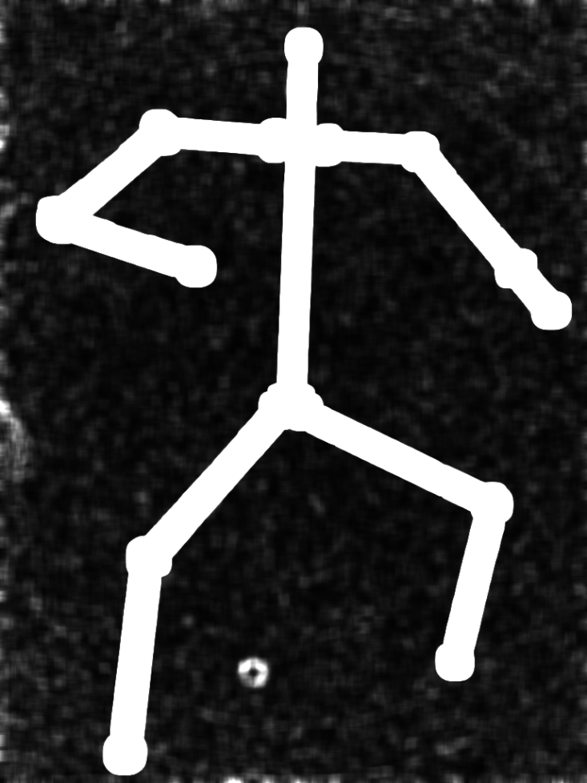
Feature detection
Finally, we look for connections between joints by tracing a line between every possible pair of nodes (Bresenham's algorithm)
If the line traced is sufficiently parallel (using a small threshold) to one of the infinite lines obtained, then there is a possible connection.

Slide 18
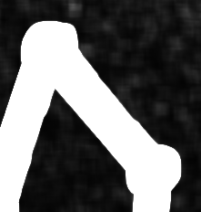
Feature detection
To be sure, we apply the Harris edge detector with a high aperture size to ensure high values along the whole object on the parts with bigger gradient difference.
We use the traced line an check the value on each pixel between the joints. If the algorithm finds a low value, then the joints are definitely not connected.

Slide 19
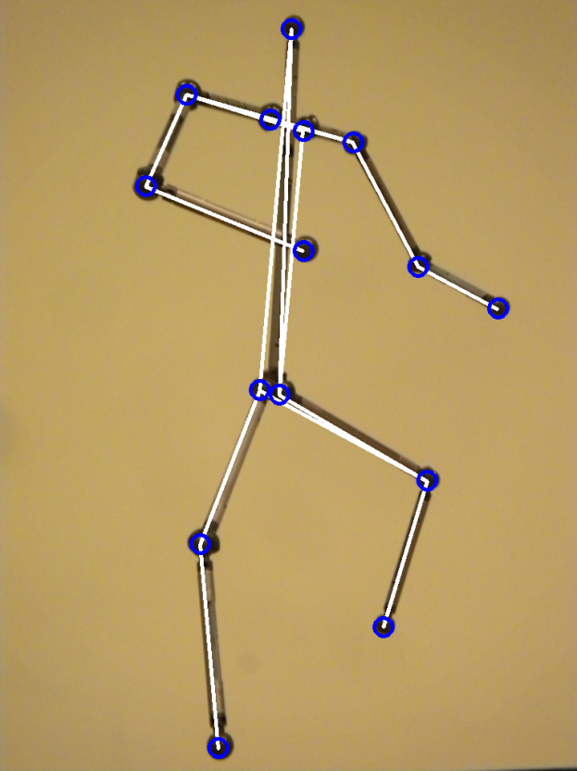
Feature detection
The last step consists in checking for ambiguities between connected joints and fix them. e.g.:

Slide 20
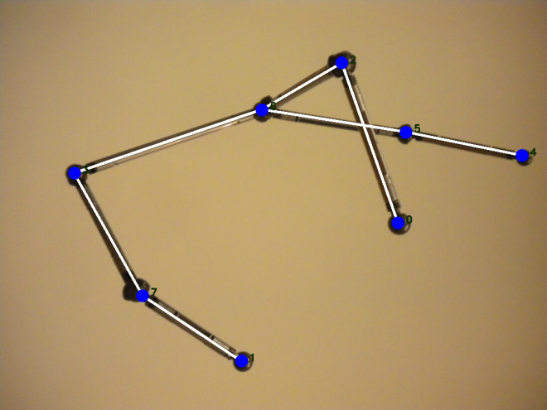
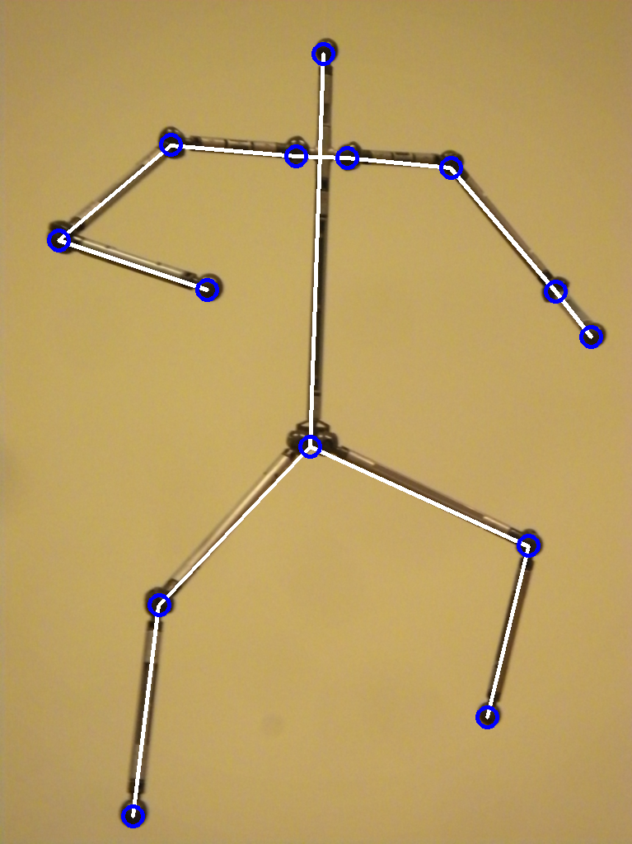
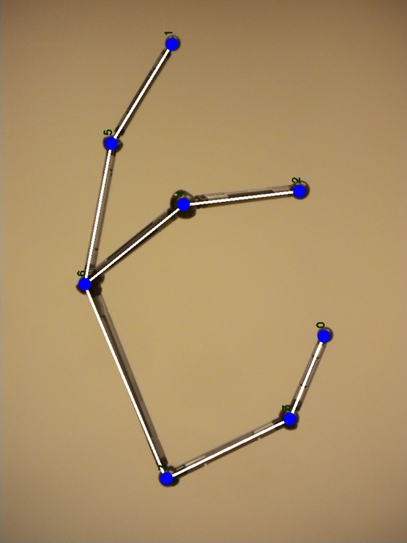
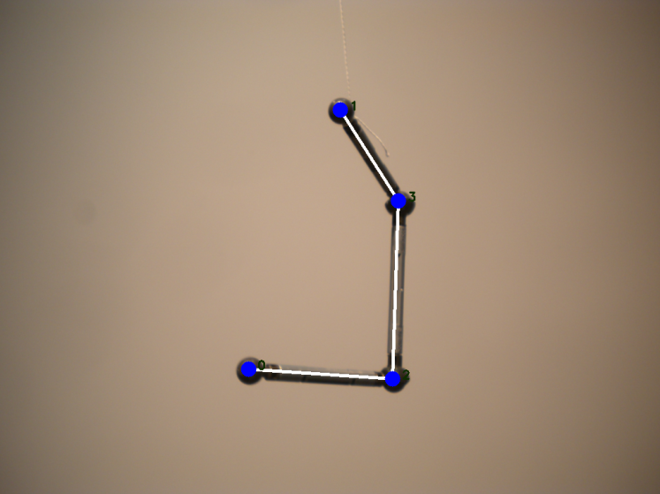
Feature detection
Final results:

Slide 21
Outline
Introduction
Related work
Feature detection
Feature correspondence
Structure reconstruction
Results and demo
Conclusions and future work

Slide 22
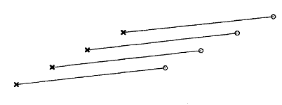
Feature correspondence
Find an assignment between corresponding feature points in two images.
Algorithm by [Scott and Longuet-Higgins, 1991] balances two principles:
  ‘Principle of proximity’ (favor short distance matches).
  ‘Principle of exclusion’ (avoid many-to-one correspondences).

Slide 23
Feature correspondence
Key elements of algorithm:
Maximizes the inner product of two matrices, the desired ‘pairing matrix’ P and a ‘proximity matrix’ G.
Exclusion emerges from the requirement for rows in P to be mutually orthogonal.

Slide 24
Feature correspondence
Algorithm outline:
Compute proximity matrix G, using the Gaussian form .
Perform a singular-value decomposition (SVD) on G = UDV ^{T}. U and V are orthogonal.
Convert D into matrix E by replacing D_{ii} for 1.
Compute P = UEV ^{T}.

Slide 25
Feature correspondence
Ideal setting: P is permutation matrix which maps features.
Real setting: P values represent matching probabilities between features points.
If P_{ij} is the greatest element in row and column, feature i corresponds with j.
For sufficient large σ, recovers matches from translation, shear and expansion.

Slide 26
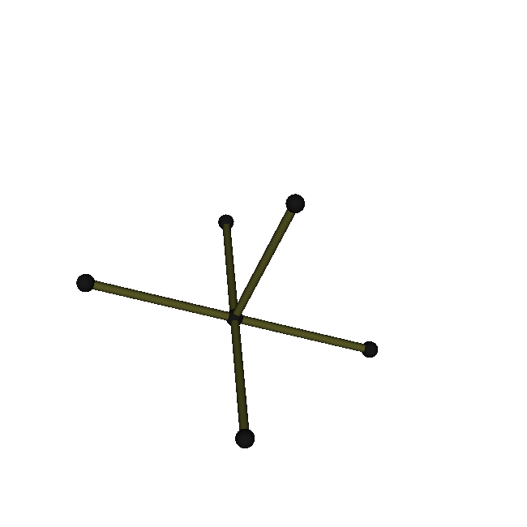

Feature correspondence

Slide 27
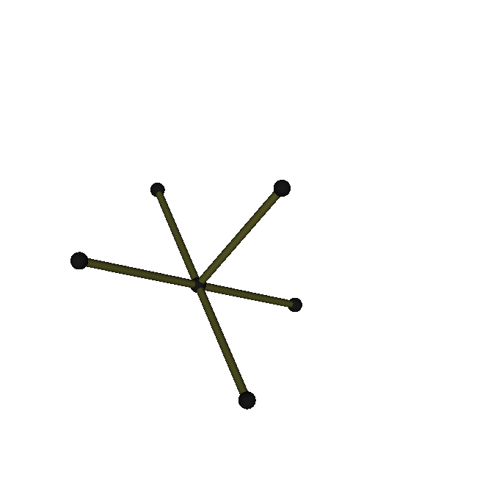

Feature correspondence

Slide 28
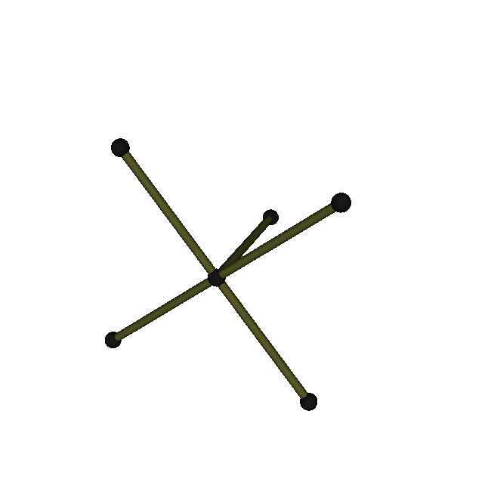

Feature correspondence

Slide 29
Outline
Introduction
Related work
Feature detection
Feature correspondence
Structure reconstruction
Results and demo
Conclusions and future work

Slide 30
Structure reconstruction
Assuming an orthographic camera model, we can use [Tomasi-Kanade, 1992] factorization algorithm as an initial estimation.
We can later remove the effects of affine distortion by using rigid link constraints [Liebowitz and Carlsson, 2001].

Slide 31
Structure reconstruction
Tomasi-Kanade factorization algorithm:
An orthographic camera with stacked projections of all points p in all frames f can be represented as
where
  W = stacked projected coords.
  M = stacked rotation.
  S = stacked 3D coords.
  T = stacked translation.

Slide 32
Structure reconstruction
  We can eliminate translation by centering coordinates around origin:
  Having from the pictures, we wish to obtain and .
  The SVD of will give us a similar representation .
  We keep the three greatest eigenvalues and define and .

Slide 33
Structure reconstruction
  We obtained a factorization but it is no unique:
  Constraints for A:

Slide 34
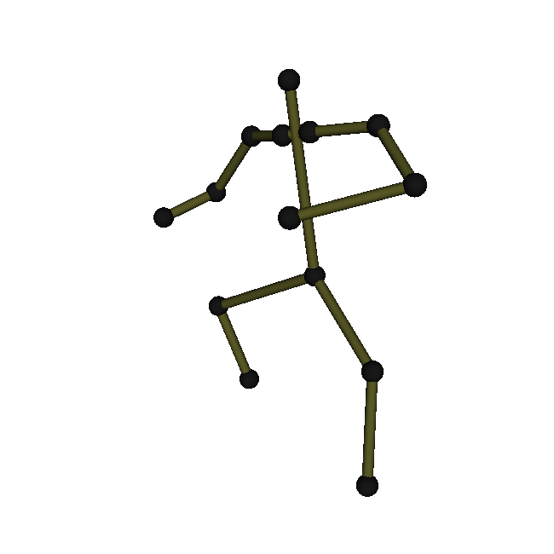
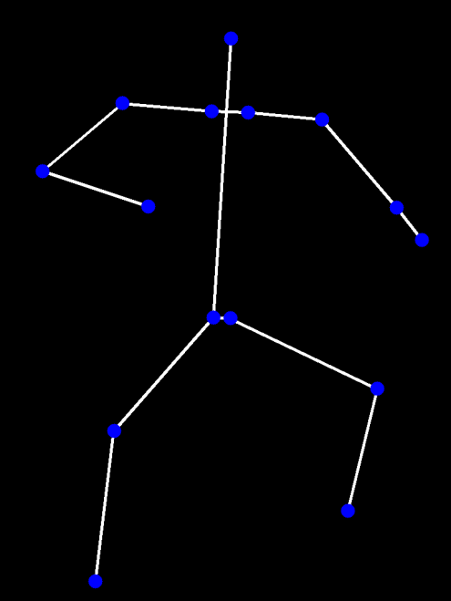
Structure reconstruction
  To solve, define and solve for C. Then A can then be obtained by a Cholesky decomposition.
  With A, we can now calculate and , and reconstruct.

Slide 35
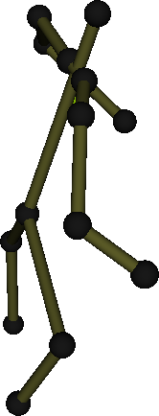
Structure reconstruction
Now we want to remove the distortion introduced by the reconstruction.
We use rigid constraints the structure presents. These are obtained considering the constant length of segments.

Slide 36
Structure reconstruction
With the affine 3D transformation W = HA + t.
We can ignore translation and apply QR factorization to H. Now W = SUA.
Constraints in world coordinates automatically induce constraints in U.

Slide 37
Structure reconstruction
We can define .
Having 3D line segments with endpoints A₁, A₂, and length l_{A}:
Considering a second line:

Slide 38
Structure reconstruction
At least 6 constraints are required to solve Ω.
Coefficient vectors c_{n} can be combined into a combined constraint matrix C. Our constriants come from λ = 1.
SVD of C and Cholesky decomposition of the resulting estimate of Ω yields rectification matrix U.

Slide 39
Outline
Introduction
Related work
Feature detection
Feature correspondence
Structure reconstruction
Results and demo
Conclusions and future work

Slide 40
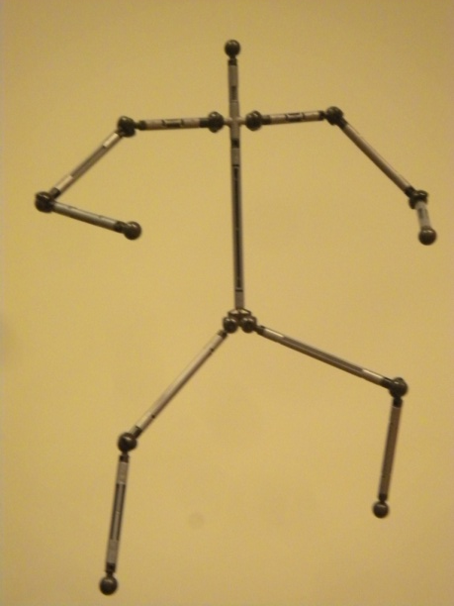
Results and demo

Slide 41
Outline
Introduction
Related work
Feature detection
Feature correspondence
Structure reconstruction
Results and demo
Conclusions and future work

Slide 42
Conclusion and future work
Ameliorate the features detection algorithm and add more filters for it to make it more robust.
Extend our method so that it can also detect joint articulation, perhaps from real time video.
Extend our method to be used with other types of thin structures.

Slide 43
Thank you!
(Questions?)

